Slide 1
354 - minor project
Image classification using CNN

Slide 2
Introduction
This project is all about building a model to classify images appropriately using the CIFAR - 10 dataset.
We have used CNN (python, tensorflow) for this project purpose.
This comes under the paradigm of Deep learning where we try to imitate the way humans gain some type of knowledge.

Slide 3
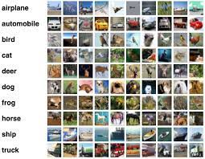
The CIFAR-10 Dataset
The dataset has a total of 60,000 images
of which 50,000 are used to train the
Model and 10.000 are used for testing
purpose.
It has images which belong to different
categories like cars,planes,deers etc…
Each image is of size 32*32*3 .

Slide 4
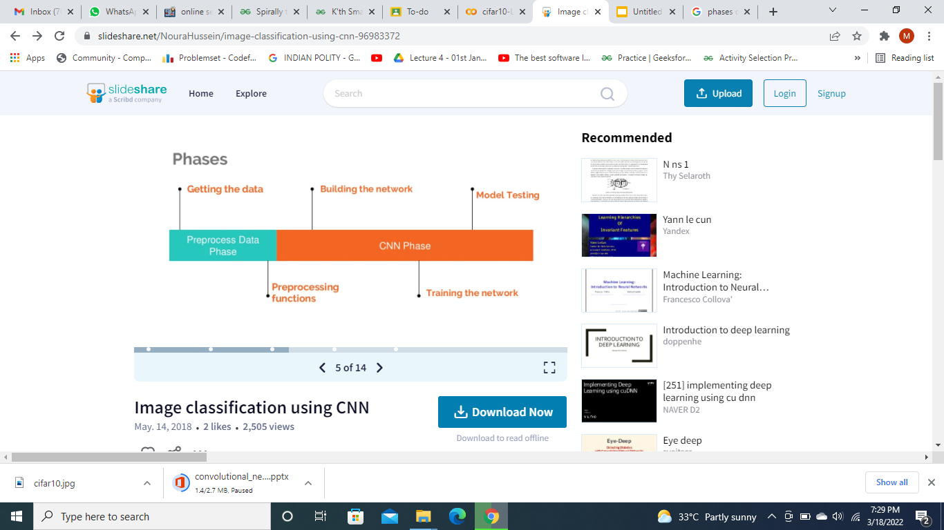
Phases

Slide 5
Data Preprocessing
First step is collecting appropriate data and preprocessing the data which is a very important step in building the model.
We first convert the datatype to float for computational purpose and normalize the data by dividing by 255.
Also,we use one hot encoding to convert the categorical indices to binary format.

Slide 6
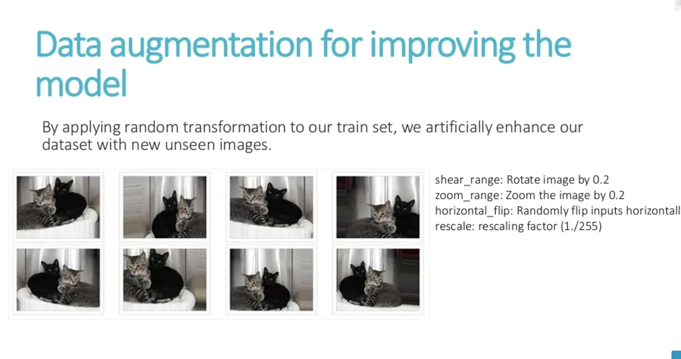

Slide 7
What is CNN ?
CNNs are fully connected feed forward neural networks.
CNNs are trained to identify the parameters like edges of objects in any image.
CNNs are very effective in reducing the number of parameters without losing on the quality of models. Images have high dimensionality (as each pixel is considered as a feature) which suits the above described abilities of CNNs

Slide 8
Continued…
CNN is mainly used to extract features from the images.
It contains a set of kernels (filters), parameters which are to be learned throughout the trainings.
Each filter convolves with the image and feature maps are created.

Slide 9
CNN Building Blocks
Convolution Layer
Pooling Layer
ReLu Layer (Activation function)
Fully Connected Layer

Slide 10

CNN

Slide 11
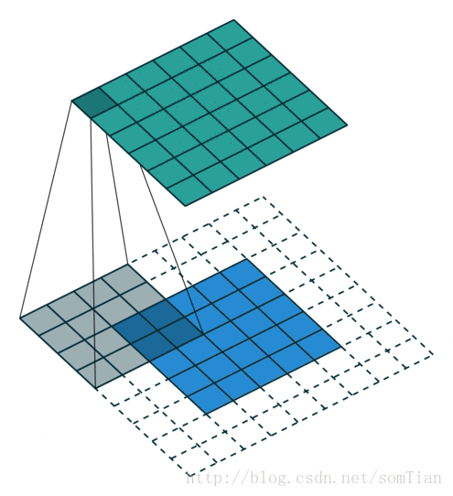
Convolutional kernel
This is a gif image

Slide 12
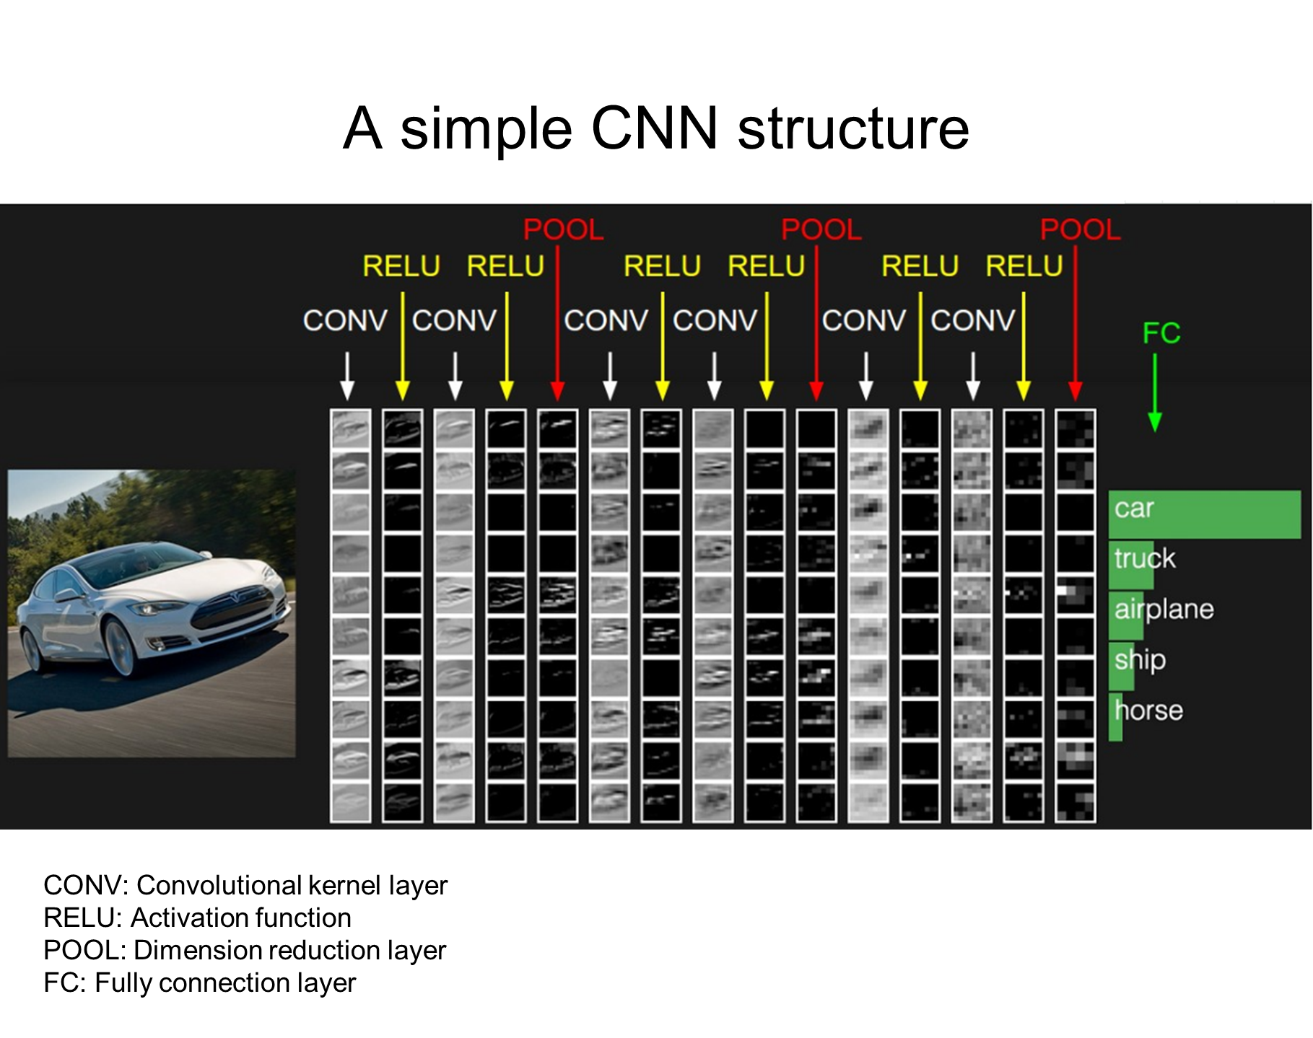

Slide 13
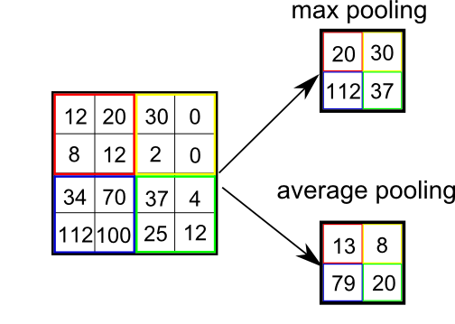
Pooling

Slide 14
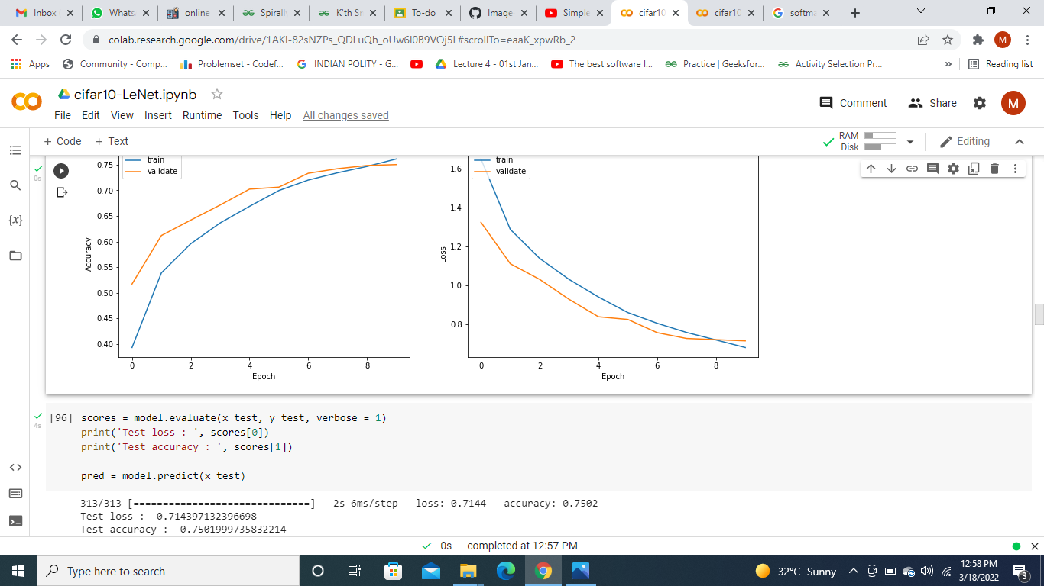
Average Pooling

Slide 15
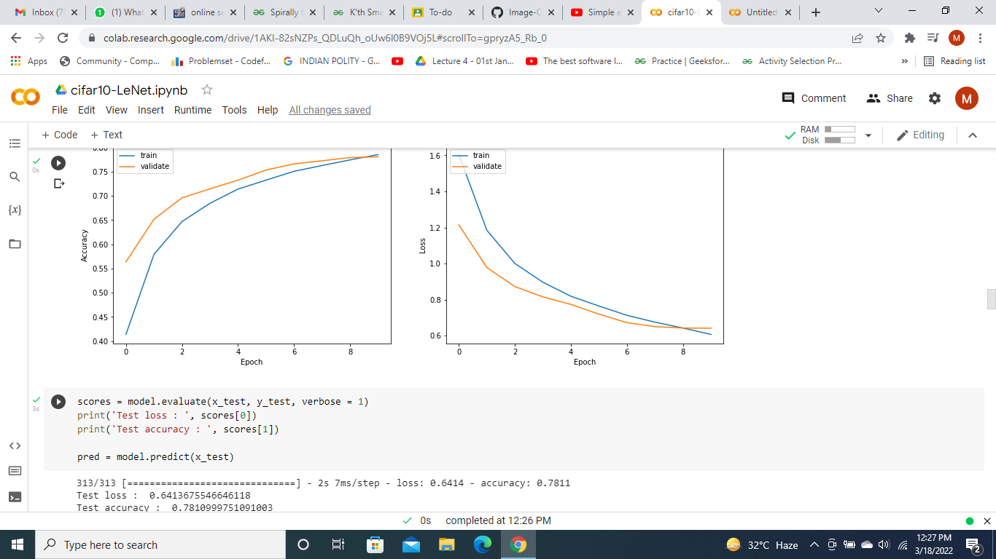
Max pooling

Slide 16
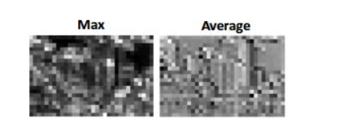
Pooling
Max pooling selects the brighter pixels from the image. It is useful when the background of the image is dark and we are interested in only the lighter pixels of the image. In average pooling method all of the pixel values are used for feature mapping and creating output, hence creating a very generalized computation.

Slide 17
Activation Function
Simply put, an activation function is a function that is added into an artificial neural network in order to help the network learn complex patterns in the data. When comparing with a neuron-based model that is in our brains (biological comparison), the activation function is at the end deciding what is to be fired to the next neuron.
Some of the well known activation functions are ReLu, sigmoid, tanh, softmax,etc…

Slide 18
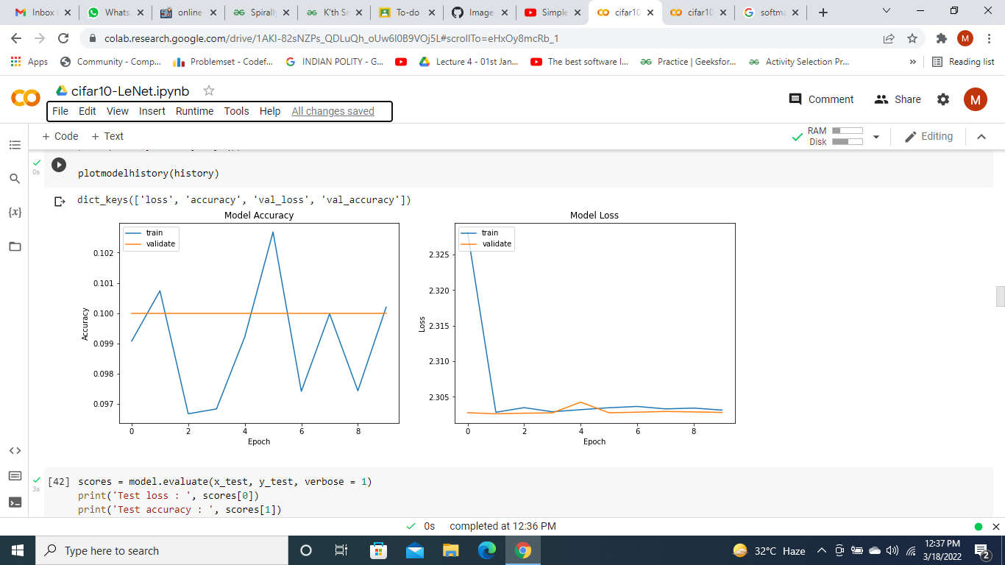
Softmax function (multiclass)

Slide 19
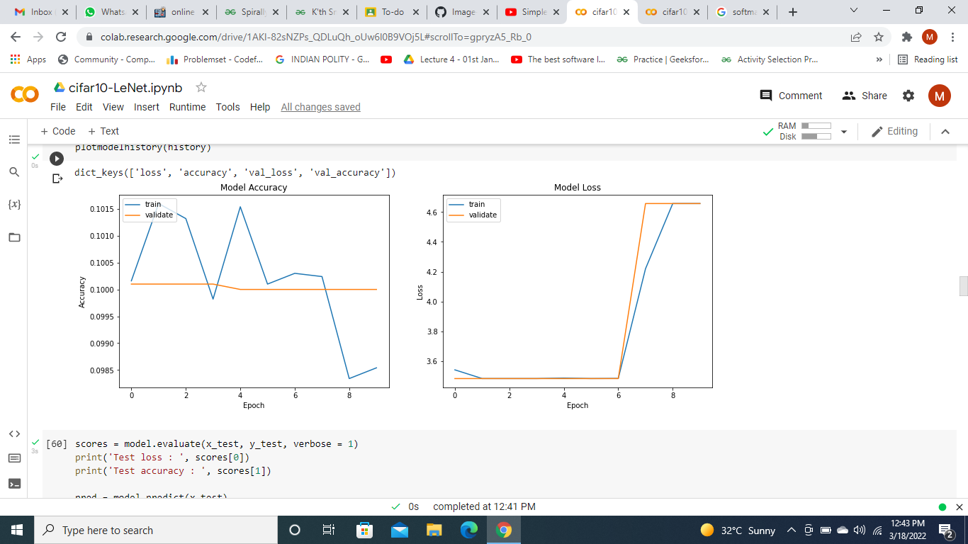
Relu function

Slide 20
Unexpected outputs
The previous two graphs where we used relu activation functions gave us unexpected outcomes as seen in the graphs,
Relu is generally applied at the output layer only in the case of binomial class classification.
Tanh suffers from vanishing gradient problem.This leads to a case where new weights after updation are very similar to the old weights and this may lead to the model not being converged.

Slide 21
LeNet-5
Lenet-5 is one of the earliest pre-trained models proposed by Yann LeCun and others in the year 1998.
The network has 5 layers with learnable parameters and hence named Lenet-5. It has three sets of convolution layers with a combination of average pooling, and 2 sets of fully connected layers.
The number of trainable parameters is 60000.

Slide 22
VGG
VGGNet. The runner-up in ILSVRC 2014 was the network from Karen Simonyan and Andrew Zisserman that became known as the VGGNet.
Its main contribution was in showing that the depth of the network is a critical component for good performance.
140 Million parameters
Size ~ 0.5GB
Useful for Image Recognition or Classification & Image Detection and Localization

Slide 23
GoogleNet
GoogLeNet. Also known as Inception Module, It dramatically reduced the number of parameters in the network (4M, compared to AlexNet with 60M). Additionally, this paper uses Average Pooling instead of Fully Connected layers at the top of the ConvNet, eliminating a large amount of parameters that do not seem to matter much. There are also several follow-up versions to the GoogLeNet, most recently Inception-v4.
The number of trainable parameters is 4 Million.

Slide 24
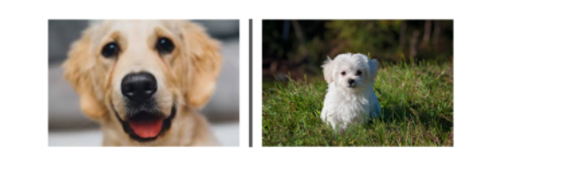
GoogleNet
Hebbian Principle: The author suggests that when creating a subsequent layer in a deep learning model, one should pay attention to the learnings of the previous layer.
Inception: Allows internal layers to pick what filter is suitable for them*
For example, the first image may require a larger filter size (CNN), whereas the second one requires a smaller one.

Slide 25
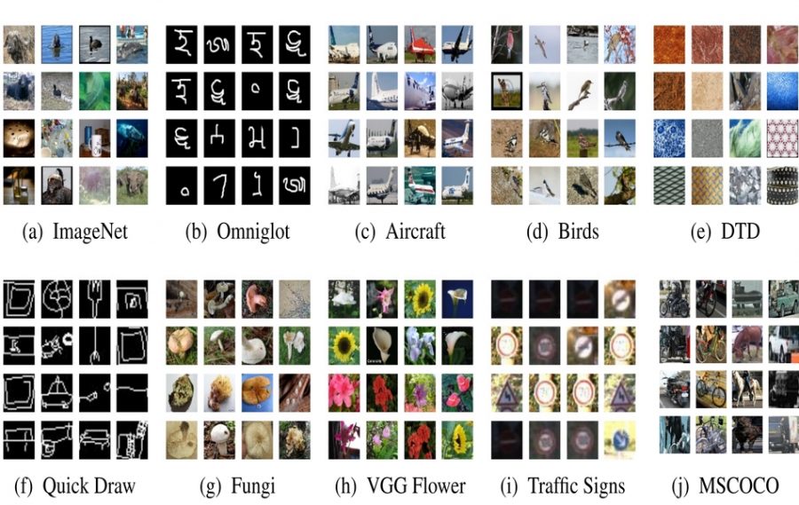
Datasets
Will our models work on different data-sets with minimum training ?

Slide 26
Some Dataset Results
Dataset | MNIST-FASHION | CIFAR-10
Accuracy | 83.33% | 78.40%

Slide 27
Tuning Hyper-parameters
Definition - Machine learning models can be fine tuned according to the problem and data available for training. This is an additional step for achieving better performance in machine learning.
Some methods are -
Bayesian search
Grid Search.
Randomized Search.

Slide 28
Tuning
Different Hyper-parameters
The hyperparameters to tune are the number of neurons, activation function, optimizer, learning rate, batch size, and epochs

Slide 29
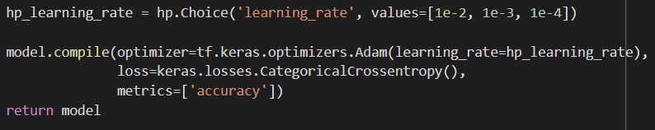
Tuning
We use HyperBand Tuner for tuning hyper parameters.
Some Code Snips

Slide 30
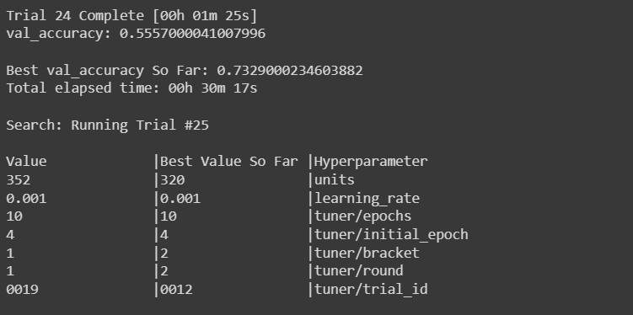
Tuning Lenet

